Slide 1


MANAGED AWS CLOUD

Slide 2
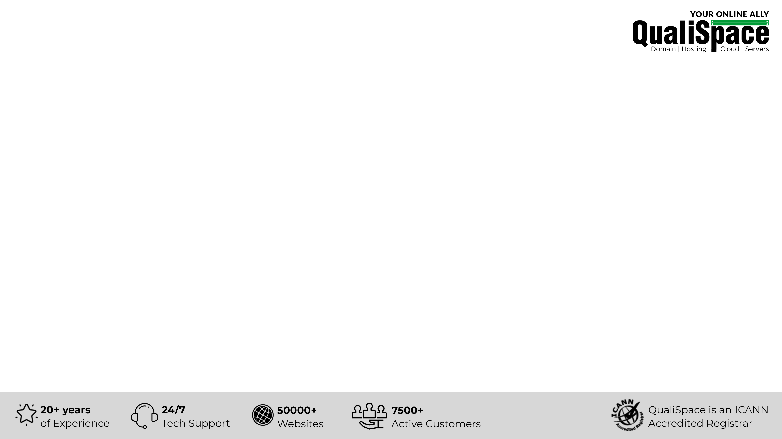
Table of Contents
About QualiSpace
Our Offerings
What is Amazon Web Services (AWS) Cloud?
Insights of AWS Cloud
Advantages of AWS Cloud
AWS management from QualiSpace
Why choose QualiSpace Managed AWS Cloud

Slide 3
About QualiSpace
ICANN ACCREDITED
ESTABLISHMENT
OUR OFFICES
An ICANN Accredited Domain Name Registrar and leading entity providing Cloud hosting services.
We have been serving the community since our inception in the year 1998.
We have active presence in India and USA with our Head Office located in Mumbai, India.
THE SQUAD
SUPPORT
CLIENTELE
AWS, Plesk/cPanel, RHCE and few more Certified specialists to ensure trouble-free services.
Connect with our technicians for immediate assistance via Call, Ticket and Chat support.
We cater to 7500+ active customers with 50000+ websites across the globe.

Slide 4






Our Offerings
Domain
Servers
Public Cloud
Domain Registration
Domain Reseller
Premium Domains
Cloud Server
Dedicated Server
Managed Dedicated Server
Managed AWS
Managed Azure
Hosting
Security & Backup
Email & Office
Free Hosting
Linux Hosting
Windows Hosting
Reseller Hosting
Digital Certificates (SSL)
SiteLock
CodeGuard
SpamExperts
Biz Mail
Business Email
G Suite
Office 365

Slide 5

What is Amazon Web Services (AWS)?
AWS is a cloud computing platform by Amazon which enables you to easily manage and deploy IT workloads. It provides services like compute, storage, database, content delivery, media streaming, serverless computing and many more.
With AWS, you can easily deploy your application or IT workload at zero Capex.
Applications of any scale can be deployed on AWS with reduced costs helped by the Pay Per Use model which ensures you pay only for what you use.
Auto scaling features help to easily manage sudden spikes in traffic and avoid downtime during peak load.

Slide 6
Insights of AWS Cloud
Spans across 61 Availability Zones within 20 geographic regions around the world.
No.1 cloud computing platform with 33% public cloud market share.
1/3 of All internet users visits websites daily that is built upon AWS.
Netflix, one of its biggest customers, spends nearly $25 million a month on AWS.
AWS has customers from over 190 countries with over a million active customers.

Slide 7





Advantages of AWS Cloud
Persistent
Storage
Durable
Storage
Scalable
Flexibility to scale resources to run any type of workload along with on-demand compute instances with pay as you go model.
Reliable, available and persistent block storage with high degree
of durability in the form of EBS storage.
Store thousands of objects sizing upto 5 terabytes with highly resistant S3 storage for data backups, static files and more.
CDN
Database
as a Service
Amazon allows CDN services through Cloudfront using its global content delivery network with 166 Points of Presence.
Acquire the broadest range of databases purpose-built for your specific application use cases with access to highly scalable database.

Slide 8

AWS management from QualiSpace
Assessment:
Assess the requirement to plan
the deployment strategy.
Monitoring:
24/7/365 monitoring of cloud instances and the required services.
Planning:
Defining a concrete process
to setup infrastructure in
AWS platform.
AWS
Management
Setup:
Setup the deployment of resources on the AWS platform.
Management:
Our experts manage each facet of the AWS cloud infrastructure.

Slide 9





Why Choose QualiSpace Managed AWS Cloud
24/7/365
Support
Simple
Pricing Model
Cost Effective
Managed
by Experts
Proactive
Monitoring

Slide 10











Our Esteemed Clients
Volkswagen Group
Sales Pvt. Ltd.
Raymond Apparel Limited
Esha Media Research Limited
Citizencredit
Co-op Bank Ltd.
Anchor Health & Beauty Care Pvt. Ltd.
PriyaGold
Mercedes
CreativeLand Asia
IDFC Bank Limited
Valecha Engineering
Kanakia Group
Bharat Book Bureau

Slide 11

THANK YOU
QualiSpace Web Services Private Limited
India Office: 602, Avior, Nirmal Galaxy, LBS Marg, Mulund West, Mumbai – 400080 I Tel: +91 22 6142 6099
USA Office: 1250 Broadway Suite 3600 New York City New York – 10001 I Tel: +1 212 401 6235
Email: sales@QualiSpace.com

