Slide 1


MANAGED AZURE CLOUD

Slide 2
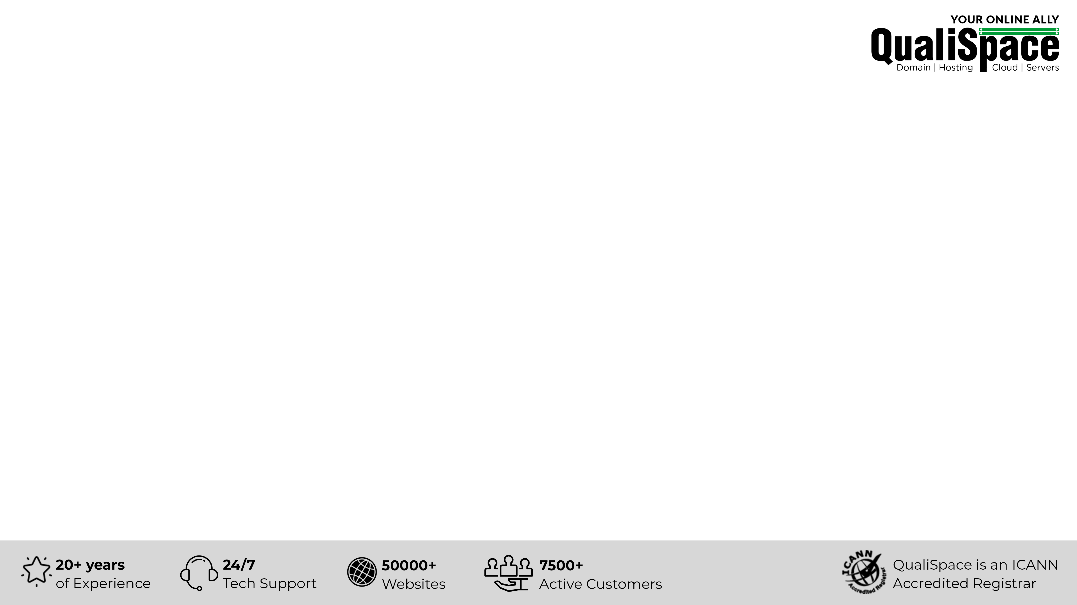
Table of Contents
About QualiSpace
Our Offerings
What is Azure Cloud?
Insights about Azure Cloud
Advantages of Azure Cloud
Azure management from QualiSpace
Why choose QualiSpace Managed Azure Cloud

Slide 3
About QualiSpace
ICANN ACCREDITED
ESTABLISHMENT
OUR OFFICES
An ICANN Accredited Domain Name Registrar and leading entity providing Cloud hosting services.
We have been serving the community since our inception in the year 1998.
We have active presence in India and USA with our Head Office located in Mumbai, India.
THE SQUAD
SUPPORT
CLIENTELE
AWS, Plesk/cPanel, RHCE and few more Certified specialists to ensure trouble-free services.
Connect with our technicians for immediate assistance via Call, Ticket and Chat support.
We cater to 7500+ active customers with 50000+ websites across the globe.

Slide 4






Our Offerings
Domain
Servers
Public Cloud
Domain Registration
Domain Reseller
Premium Domains
Cloud Server
Dedicated Server
Managed Dedicated Server
Managed AWS
Managed Azure
Hosting
Security & Backup
Email & Office
Free Hosting
Linux Hosting
Windows Hosting
Reseller Hosting
Digital Certificates (SSL)
SiteLock
CodeGuard
SpamExperts
Biz Mail
Business Email
G Suite
Office 365

Slide 5

What is Azure Cloud?
Microsoft Azure is a cloud computing service created by Microsoft for building, testing, deploying, managing applications and services through Microsoft-managed datacenters.
Azure provides a range of cloud services, including those for compute, analytics, storage and networking.
Azure provides over 600 services under IaaS, SaaS, PaaS, DBaaS and DRaaS. It also has one of the lowest prices in Public Cloud Market.
Azure provides Hybrid model in form of Bring Your Own License (BYOL) which helps in reducing cost.

Slide 6
Insights about Azure Cloud
Azure is the second largest Public Cloud Provider.
Azure has 54 regions worldwide, more than any cloud provider.
Azure has presence in over 140 countries.
Microsoft Azure is the fastest growing cloud platform in the world.
More than 5 million Organizations in the world use Azure Cloud.

Slide 7





Advantages of Azure Cloud
Scalable
Persistent Storage
Enjoy flexibility of scaling resources to run any type of workload.
It gives persistent, high performance disk storage for any type of programs.
Database as a service
Intelligent, relational cloud database service with enterprise-grade performance & built-in high availability.
CDN
Blob Storage
Reduce load times,
save bandwidth,
speed responsiveness
for multimedia files.
Optimize massive amount of unstructured data with highly durable, scalable & redundant blob storage.

Slide 8

Azure management from QualiSpace
Assessment
Planning
Setup
Assess the requirement to plan the deployment strategy.
Defining a concrete process to setup infrastructure in Azure platform.
Setup the deployment of resources on the Azure platform.
Management
Monitoring
Our experts manage each facet of the Azure cloud infrastructure.
24/7/365 monitoring of cloud instances and the required services.

Slide 9





Why Choose QualiSpace Managed Azure Cloud
a
Cost Effective
24/7/365 Support
b
c
Managed by Experts
d
Simple Pricing Model
e
Proactive Monitoring

Slide 10











Our Esteemed Clients
Volkswagen Group
Sales Pvt. Ltd.
Raymond Apparel Limited
Esha Media Research Limited
Citizencredit
Co-op Bank Ltd.
Anchor Health & Beauty Care Pvt. Ltd.
PriyaGold
Mercedes
CreativeLand Asia
IDFC Bank Limited
Valecha Engineering
Kanakia Group
Bharat Book Bureau

Slide 11

THANK YOU
QualiSpace Web Services Private Limited
India Office: 602, Avior, Nirmal Galaxy, LBS Marg, Mulund West, Mumbai – 400080 I Tel: +91 22 6142 6099
USA Office: 1250 Broadway Suite 3600 New York City New York – 10001 I Tel: +1 212 401 6235
Email: sales@QualiSpace.com

