Slide 1

CLOUD SERVER

Slide 2
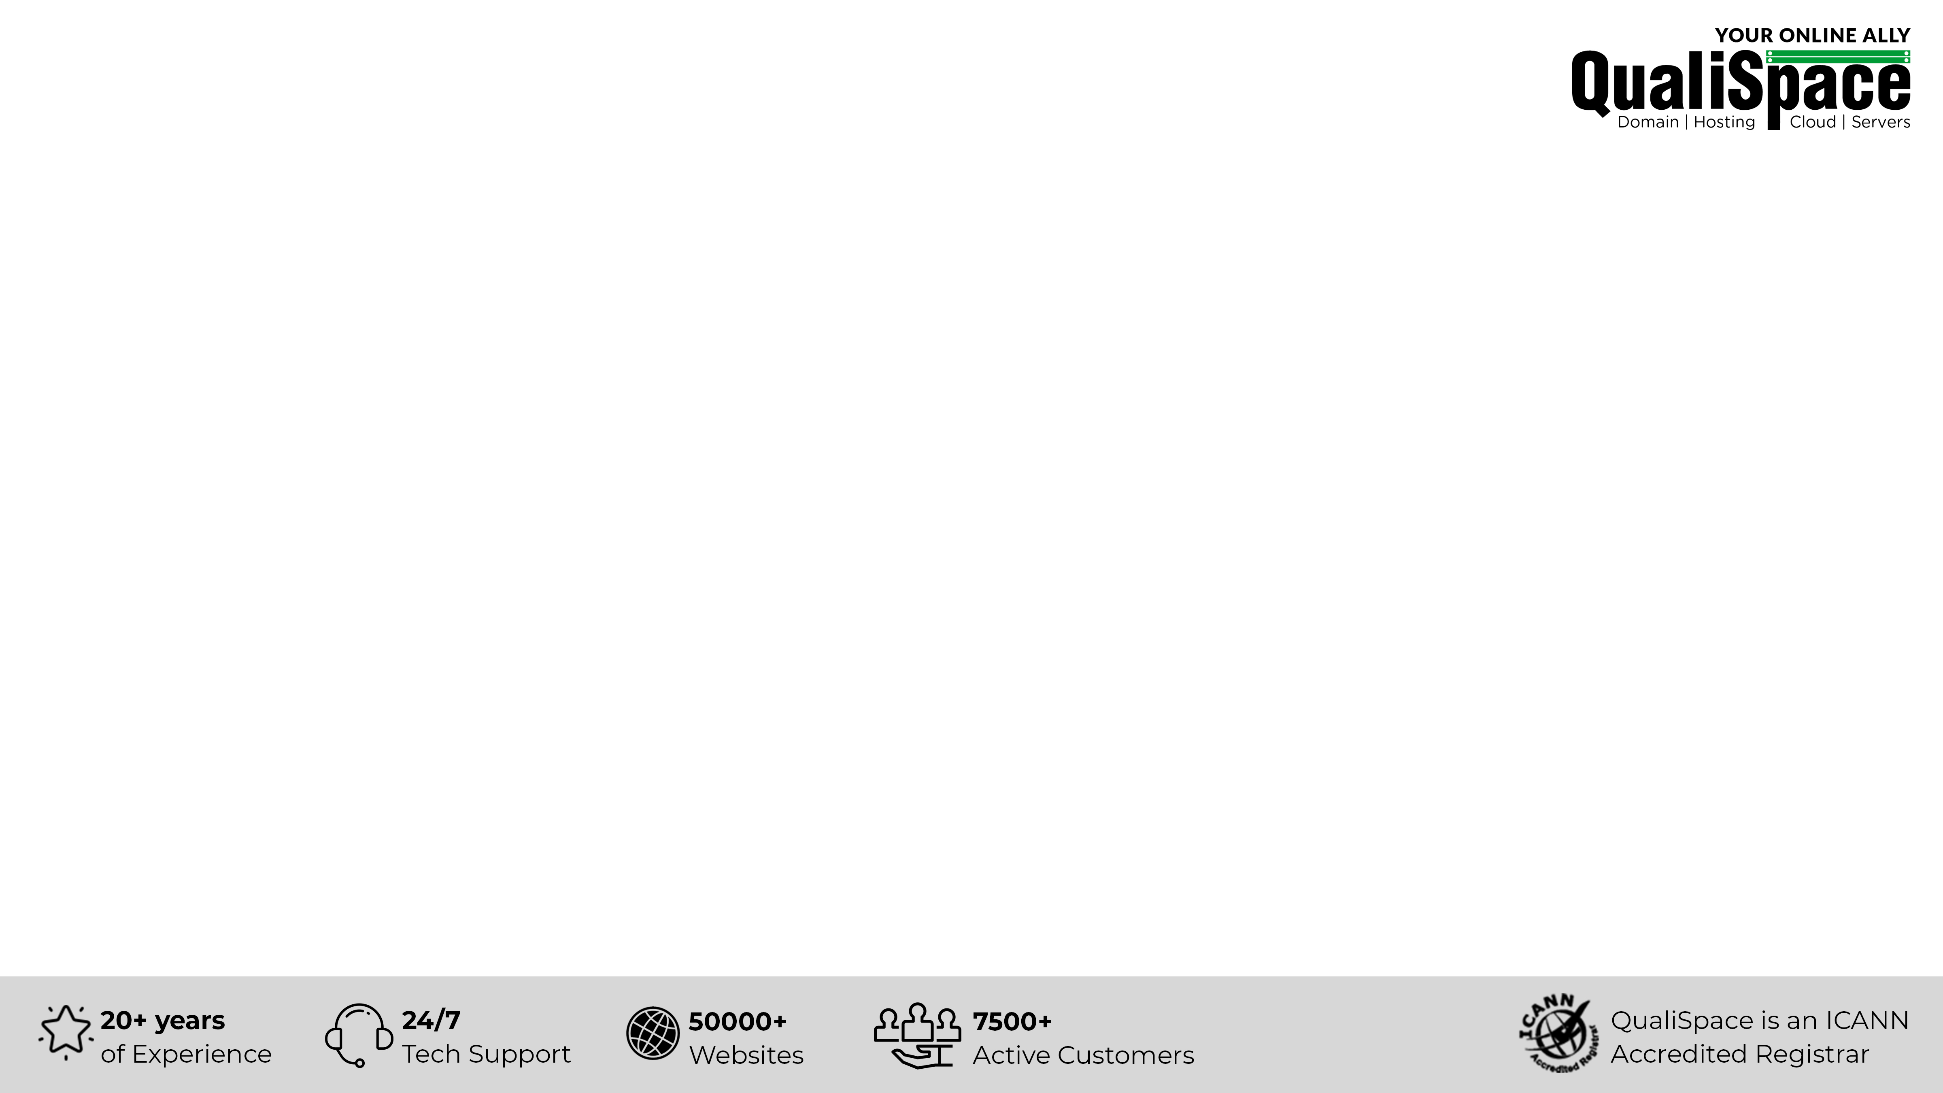
Table of Contents
About QualiSpace
Our Offerings
What is Cloud and its Types
What is Cloud server
Advantages of migrating to Cloud server
Fully-Managed V/s Self-Managed Cloud Server
Why choose QualiSpace Cloud server?

Slide 3
About QualiSpace
ICANN ACCREDITED
ESTABLISHMENT
OUR OFFICES
An ICANN Accredited Domain Name Registrar and leading entity providing Cloud hosting services.
We have been serving the community since our inception in the year 1998.
We have active presence in India and USA with our Head Office located in Mumbai, India.
THE SQUAD
SUPPORT
CLIENTELE
AWS, Plesk/cPanel, RHCE and few more Certified specialists to ensure trouble-free services.
Connect with our technicians for immediate assistance via Call, Ticket and Chat support.
We cater to 7500+ active customers with 50000+ websites across the globe.

Slide 4






Our Offerings
Domain
Servers
Public Cloud
Domain Registration
Domain Reseller
Premium Domains
Cloud Server
Dedicated Server
Managed Dedicated Server
Managed AWS
Managed Azure
Hosting
Security & Backup
Email & Office
Free Hosting
Linux Hosting
Windows Hosting
Reseller Hosting
Digital Certificates (SSL)
SiteLock
CodeGuard
SpamExperts
Biz Mail
Business Email
G Suite
Office 365

Slide 5



What is Cloud?
Cloud is a global network of remote servers that reside in a multi-tenant virtualized environment. It is built, deployed and run using cloud computing platform.
Types of Cloud?
Public Cloud
Private Cloud
Hybrid Cloud
Provides infrastructure and services to public via internet and making it available to use for anyone.
Provides infrastructure dedicated to one business which is either hosted on organization's on-site datacenter or with a 3rd-party cloud service provider.
You get the best, as it combines both public cloud and private cloud infrastructure for better flexibility and deployment of resources.

Slide 6



What is Cloud Server?
Cloud server is a virtual server
that operates through a virtual environment.
This virtualized environment is created by dividing a physical server into multiple
virtual servers.
All these servers are built, deployed and run on cloud platform via internet which is remotely accessed.

Slide 7
Advantages of migrating to Cloud Server
Computing infrastructure that is physical, virtual or a combination of both.
Allows scaling up
or scaling down of resources to suit business needs.
Easy processing
of intensive workloads & store large volumes of information.
Cost-effective alternative of
Dedicated server.

Slide 8
Fully Managed v/s Self Managed Cloud Server
Fully Managed
Self Managed
Fully Managed Cloud Server
V/s
Self Managed Cloud Server
We take total charge of your server management and maintenance without you worrying about the technicalities of running an internet server.
In this case, the servers are managed entirely by the users. Users take full control of maintenance or management of server and resources.
Benefits of Fully Managed Cloud Server:
Eliminate the hassle of server maintenance and management.
File backup and daily scanning for rapid restoration, if necessary.
Assisted migration service for smooth transition.

Slide 9
Why Choose QualiSpace Cloud Server
01
Enterprise Grade Servers to boost performance.
02
Full root/remote access to manage servers.
03
On-demand scaling of network resources.
04
Located in Tier III and Tier IV Datacenters in US and India.
05
24/7 technical support to resolve your server queries.

Slide 10











Our Esteemed Clients
Volkswagen Group
Sales Pvt. Ltd.
Raymond Apparel Limited
Esha Media Research Limited
Citizencredit
Co-op Bank Ltd.
Anchor Health & Beauty Care Pvt. Ltd.
PriyaGold
Mercedes
CreativeLand Asia
IDFC Bank Limited
Valecha Engineering
Kanakia Group
Bharat Book Bureau

Slide 11

THANK YOU
QualiSpace Web Services Private Limited
India Office: 602, Avior, Nirmal Galaxy, LBS Marg, Mulund West, Mumbai – 400080 I Tel: +91 22 6142 6099
USA Office: 1250 Broadway Suite 3600 New York City New York – 10001 I Tel: +1 212 401 6235
Email: sales@QualiSpace.com

